Slide 1
Interaksi Manusia dan Komputer (IMK)
Pengantar IMK

Slide 2
Tujuan Mata Kuliah IMK
Setelah mengikuti mata kuliah ini mahasiswa dapat:
“Merancang antarmuka perangkat lunak yang memenuhi prinsip User Interface (UI) yang benar”

Slide 3
Outline
Definisi IMK
Pentingnya desain UI yang baik
Perkembangan IMK
Tren UI/UX
Interaction Framework
Interaction Style
Karakteristik GUI dan WebUI

Slide 4
Definisi Interaksi Manusia Komputer

Slide 5
Definisi IMK/HCI
Human-computer interaction is the study, planning, and design of how people and computers work together so that a person’s needs are satisfied in the most effective way (Galitz, 2007)
Human-computer interaction is a discipline concerned with the design, evaluation and implementation of interactive computing systems for human use and with the study of major phenomena surrounding them (Hewett et al, 1996)

Slide 6
HCI / IMK
Pada saat melakukan design antarmuka kita perlu memperhatikan beberapa hal:
apa keinginan dan harapan orang terhadap produk yang dibangun,
apa batasan dan kemampuan fisik para penggunanya,
memperhatikan user experience dari pengguna produk, Pertimbangkan apa yang menurut pengguna baik dan buruk dari antarmuka yang dirancang, dan
Lakukan selalu test dan retest agar mendapatkan design antarmuka yang sesuai dengan kebutuhan pengguna.
Perancang juga harus memperhatikan karakteristik dan batasan teknis dari perangkat keras dan perangkat lunak komputer

Slide 7
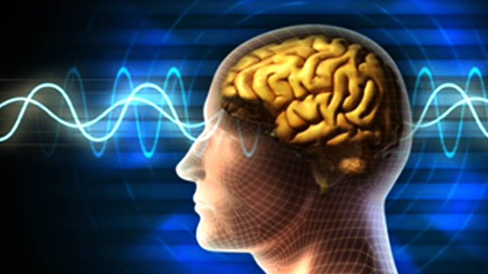
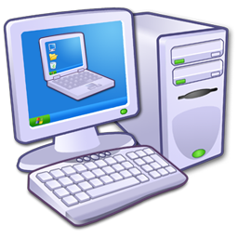
Manusia Vs Komputer
Komputer:
tidak fleksibel / tidak mampu beradaptasi,
input harus dalam format yang jelas & output harus didefinisikan sebelumnya,
tidak dapat belajar,
dapat didesain ulang
Interaksi
Manusia:
fleksibel & mampu beradaptasi,
dapat belajar bagaimana bekerja di lingkungan yang baru

Slide 8
Paradigma Interaksi
Paradigma interaksi adalah model atau pola interaksi manusia komputer yang mencakup semua aspek interaksi, termasuk fisik, virtual, persepsi, dan kognitif (Heim 2007).
Paradigma interaksi diidentifikasikan oleh Heim(20017) :
Large Scale Computing
Personal computing
Networked computing
Mobile Computing
Collaborative Environment
Virtual Reality
Augmented Reality

Slide 9
5 W + H
Who, what, where, why, and how
5 W + H heuristic adalah prosedur yang dapat digunakan untuk mendefinisikan dan menganalisa paradigma interaksi yang ada dan ruang serta mengeksplorasi unsur-unsur dan objek dengan yang berinteraksi pengguna.
Heuristik itu terdiri dari 3 komponen :
What/How : digunakan untuk memahami komponen antarmuka fisik dan virtual.
Where/When : Hal ini terkait dengan lingkungan fisik. terlihat perbedaan antara kantor, portabel, sistem dpt dipakai.
Who/Why : ini terlihat pada jenis tugas dan keahlian yang dibutuhkan.
Petakan 5 W + H terhadap jenis paradigma interaksi menurut Heim

Slide 10
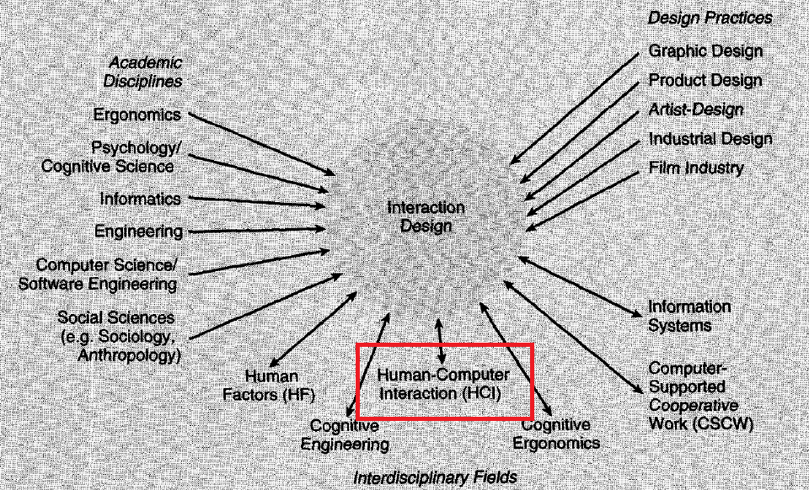
Hubungan HCI/IMK - Interaction Design
HCI/IMK merupakan disiplin ilmu yang dibutuhkan dalam merancang sebuah antarmuka sebuah produk dalam hal ini produk software
Jenny Preece, Yvonne Rogers, Helen Sharp. 2002. Interaction Design_beyond Human-Computer –Interaction, J. Wiley & Sons

Slide 11
Pentingnya Desain UI yang Baik

Slide 12
User Interface
Antarmuka/ user interface (UI) merupakan bagian dari komputer dan perangkat lunaknya yang dapat dilihat, didengar, disentuh, dan diajak bicara, baik secara langsung maupun dengan proses pemahaman tertentu.
UI yang baik adalah UI yang tidak disadari, dan UI yang memungkinkan pengguna fokus pada informasi dan task tanpa perlu mengetahui mekanisme untuk menampilkan informasi dan melakukan task tersebut.
Komponen utamanya:
Input
Output

Slide 13
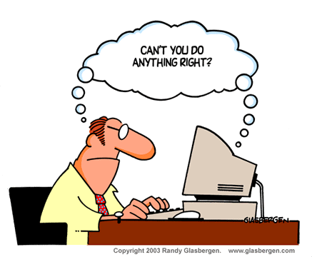
Basics of IT applications
Stand-alone application: computer program [input → do something → output]
Complex applications: Many interacting computer programs
Fundamental component:
IT applications take inputs (from sensors, humans)
Most IT applications provide outputs (to actuators, humans)
➔ A “Good” design of the User-Computer Interface is important !

Slide 14
Pentingnya Desain UI yang Baik
Banyak sistem dengan fungsionalitas yang baik tapi tidak efisien, membingungkan, dan tidak berguna karena desain UI yang buruk
Antarmuka yang baik merupakan jendela untuk melihat kemampuan sistem serta jembatan bagi kemampuan perangkat lunak
Desain yang buruk akan membingungkan, tidak efisien, bahkan menyebabkan frustasi

Slide 15
Desain UI yang Baik perlu memenuhi
Usability goals
effective to use (effectiveness)
efficient to use (efficiency)
safe to use (safety)
have good utility (utility)
easy to learn (learnability)
easy to remember how to use (memorability)
User Experience goals
Satisfying - Enjoyable
Fun - Entertaining
Helpful - Motivating
Aesthetically pleasing - Supportive of creativity
Rewarding - Emotionally fulfilling

Slide 16
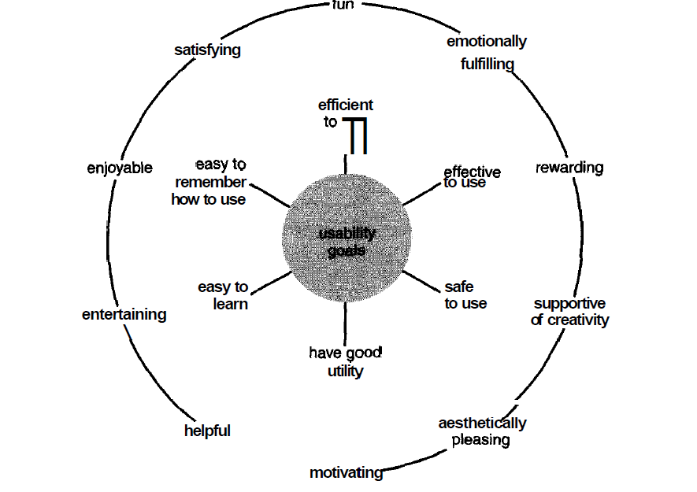
Usability dan User Experience goals
Jenny Preece, Yvonne Rogers, Helen Sharp. 2002. Interaction Design_beyond Human-Computer –Interaction, J. Wiley & Sons

Slide 17
Perkembangan IMK

Slide 18
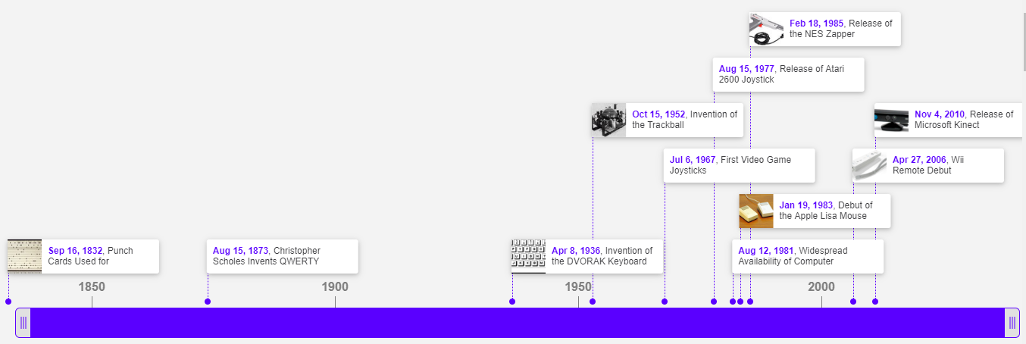
Sejarah perkembangan IMK
Sumber :
https://www.timetoast.com/timelines/history-of-human-computer-interaction
Notes:
https://www.timetoast.com/timelines/history-of-human-computer-interaction
Punch card
Invented in the early 1800s, punch cards were originally used to control looms and then in the early 20th century IBM streamlined their usage on their own machines. The reason for the demise of this human computer interface (HCI) was the affordability of better and more efficient methods.
QWERTY
After creating a successful typewriter, Christopher Scholes continued upon his work. One such improvement was the QWERTY key layout. At first this layout was created to prevent the excessive sticking of keys that users experience while using his typewriter. Needless to say that this was a success and computer keyboards world wide use the layout that Scholes created over 100 years ago.
DVORAK keyboard format
An alternative to the QWERTY keyboard layout, the Dvorak Simplified Keyboard was created to increase typing efficiency and speed as to combat the issues with the QWERTY layout. The layout was designed around the most used letters in the English language as to place those letters in closest proximity to decrease strain upon the typist. During experiments, typists using the DVORAK layout made fewer mistakes and less prone to fatigue. Although evidence shows the Dvorak layout to be better there
Trackball
The invention of the trackball that the first computer mice used for location tracking was actually done during a secret military project by Tom Cranston, Fred Longstaff and Kenyon Taylor who were all part of the Canadian Royal Navy. Due to the fact that the invention came about during a secret military project it was never patented. The first system built by the trio used a hard rubber ball like those found in the Canadian 5 pin bowling game.
Joystick
Invented to be used in conjunction with a video game console, electronic joysticks opened up a new era in human interaction with computers.
Release ATARI joystick
The Atari 2600 joystick was released with single button and a DE-9 connector.
Computer keyboard
Keyboards saw their first usage as an interface to text only terminals controlling large computer systems. Widespread and easy creation of keyboards first appeared with the creation of the personal computer by the already familiar IBM. IBM had streamlined the creation of the keyboard allowing for easy access to purchasing and usage.
Apple Lisa
Although widely used now, the mouse took nearly 20 years to see fully fledged adoption due to a lack of system support. It wasn’t until Apple Inc. debuted its system titled “Apple Lisa” that the mouse was first widely used as an interface device. Although Xerox was the first to create a system that used the mouse, it was Apple that popularized it since Xerox never released a system that used it.
NES Zapper
The NES Zapper was an accesory designed for the Nintendo Entertainment System. The Zapper used light gun technology that detected light sources on the screen to determine if a user hit a target.
Wii Remote debut
To go along with their release of their next generation gaming console, Nintendo created the Wii Remote as opposed to a traditional gaming control pad. The Wii Remote using motion sensing technology to track player gestures.
Microsoft Kinect
Microsoft’s Kinect is a tool that provides motion sensing capabilities to its Xbox 360 gaming platform. Being a motion sensing tool, it allows for users to interact with their gaming consoles without the need for controllers. The Xbox 360 provides a user interface created specially for the Kinect that allows users to use gestures and spoken commands to navigate through menus and play games.

Slide 19
Tren Interaksi Manusia Komputer

Slide 20
Smart Restaurant Table
https://www.youtube.com/watch?v=UZPwqImfBf0
https://itrestaurant.net/table
Amazing Interface & Holograms
https://www.youtube.com/watch?v=uaLWylmrpCI
https://collegeinfogeek.com/leap-gesture-computing/
Notes:
Smart Restaurant

Slide 21
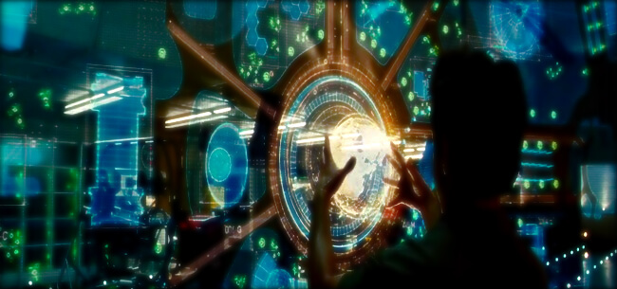
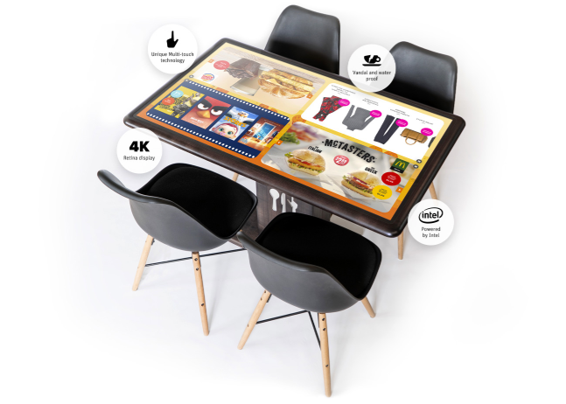
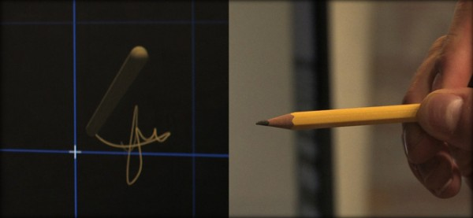
Sumber : https://collegeinfogeek.com/leap-gesture-computing/
Sumber : https://itrestaurant.net/table

Slide 22
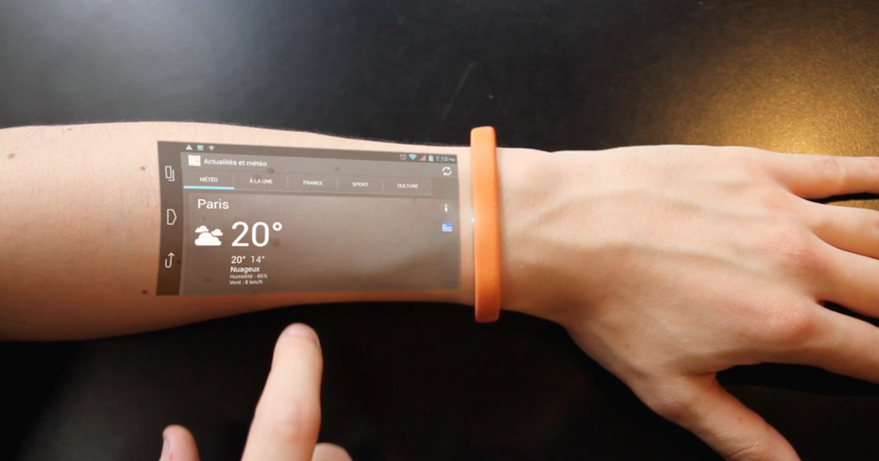
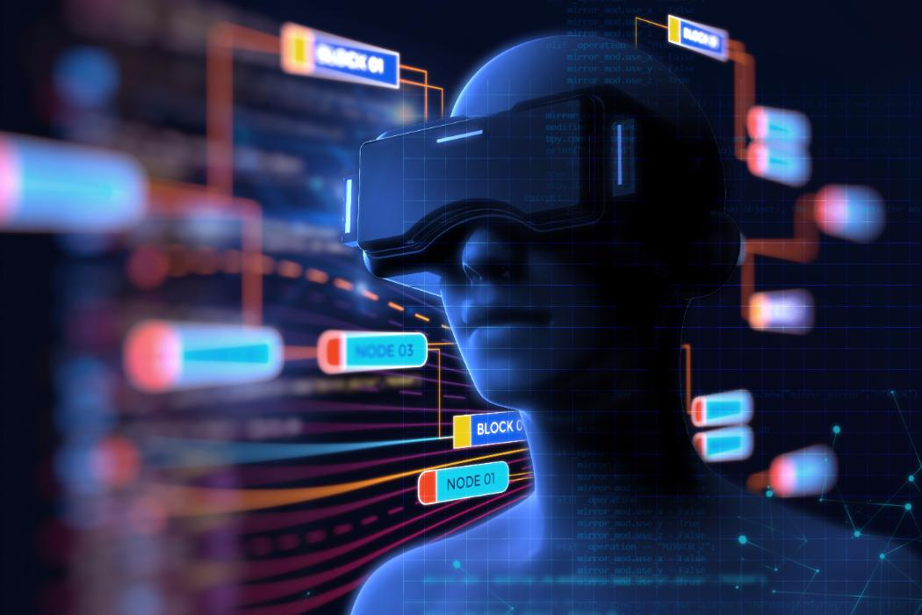
Sumber : http://sparrowkinteractiondesign.blogspot.com/2015/04/cicret-bracelet-future-hci-technologies.html
Sumber : https://www.canterbury.ac.nz/engineering/schools/csse/research/hci/

Slide 23
Interaction Framework

Slide 24
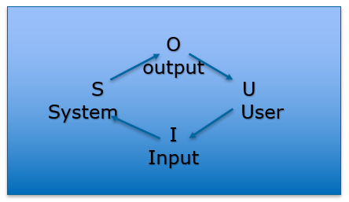
Interaction Framework
Manusia berinteraksi dengan komputer tentunya sangat komplek dan tidak mudah.
Interaction Framework

Slide 25
Interaction Style

Slide 26
Interaction Style
An interaction style is simply the method, or methods, by which the user and a computer system communicate with one another
Type of Interaction Style :
Command line
Menu-Based Interface
Form Fill in
Direct Manipulation
Anthropomorphic/Metaphors
Web Navigation
3D Environment
Zoomable interface
Natural Language

Slide 27
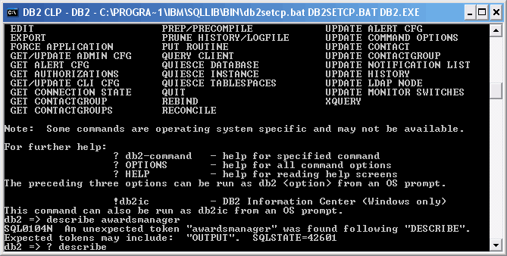

Interaction Style
Command line :
Merupakan interaction style paling awal dari teknologi computer
Powerfull for Advanced user
Complex Syntax
“Low error tolerant” sehingga bisa menyebabkan user frustasi

Slide 28
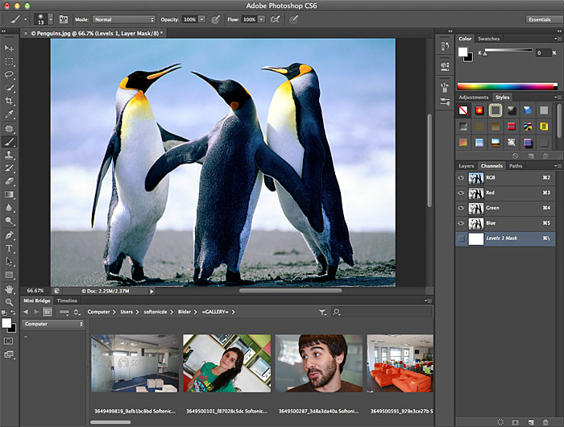
Interaction Style
Menu Selection
Trend UI saat ini di berbagai macam Aplikasi.
Utilize a person with much stronger Recognition.
Membantu bagi infrequent user.
Label Menu harus dimengerti dan memiliki arti yang jelas.

Slide 29
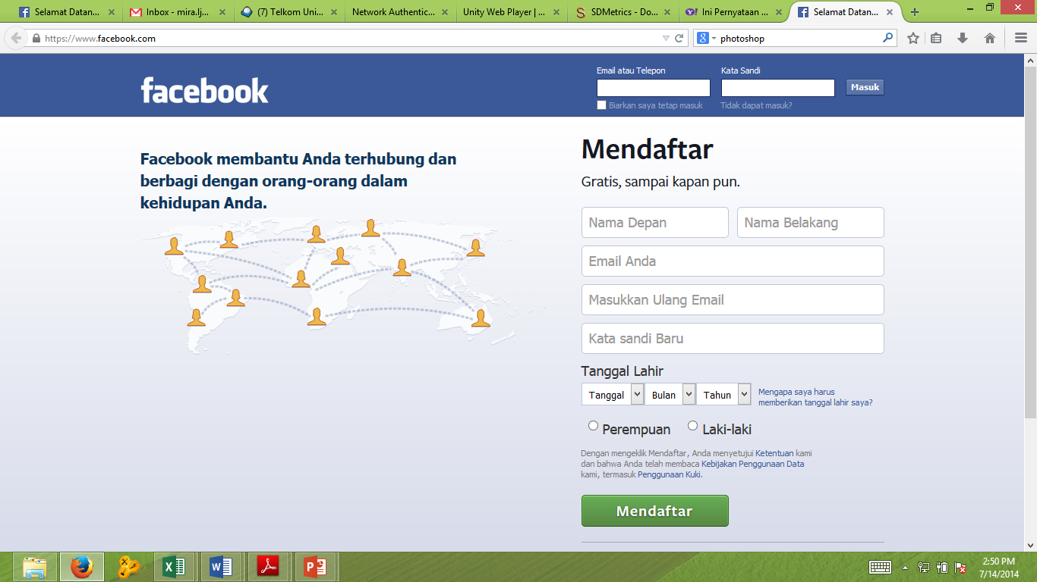
Interaction Style
Form Fill in
Sangat berguna untuk mengambil Informasi
Membutuhkan typing skill yang tinggi
Familiar dengan paper form di dunia nyata

Slide 30
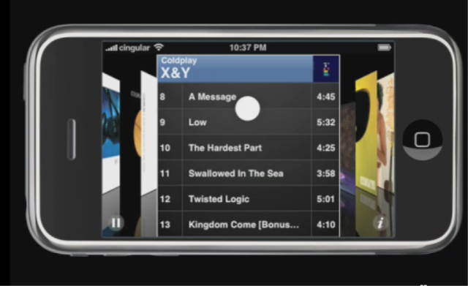
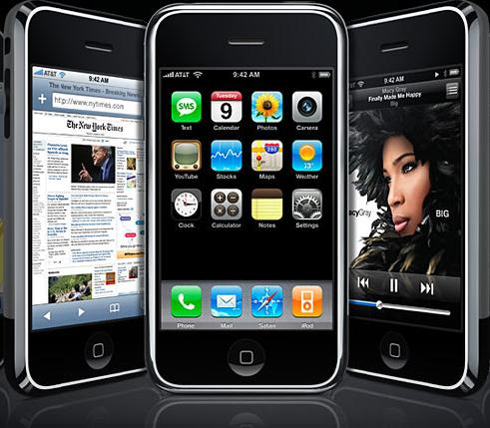
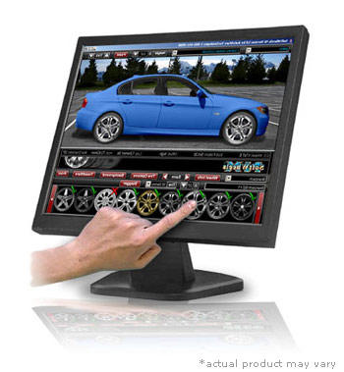
Interaction Style
Direct Manipulation
Memungkinkan User berinteraksi secara langsung bahkan memanipulasi objek yang tampil di layar

Slide 31
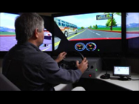
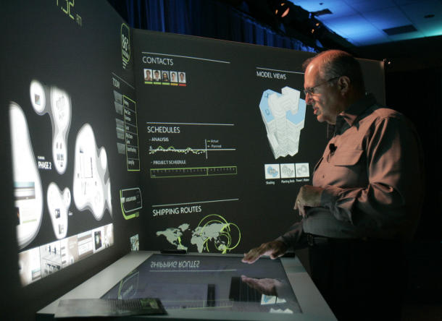
Interaction Style
Anthropomorphic
Sebuah antarmuka anthropomorphic mencoba untuk berinteraksi dengan orang-orang dengan cara yang sama seperti orang-orang berinteraksi satu sama lain. Ini mencakup dialog bahasa alami lisan, gerakan tangan, ekspresi wajah dan gerakan mata

Slide 32
Interaction Style
STYLE | ADVANTAGES | DISADVANTAGES
Command Line | Powerfull, Flexible, Appeals to expert user, Conserves screen space | Commands must be memorized, requires big learning effort, intolerant of typing errors
Menu Selection | Utilizes recognition memory, reduces interaction complexity, aids decision making process, minimize typing, aids casual users | Consumes screen space, may create complex menu hierarchies, may slow knowledgeable users
Form Fill in | Familiar format, simplifies information entry, requires minimal training | Consumes screen space, requires carefull and efficient design, does not prevent typing errors
Direct Manipulation | Faster Learning, easier remembering, exploits visual/spatial cues, easy error recovery, provides context, immediate feedback | Greater design complexity, window manipulation requirements, requires icon recognition, inefficient for touch typist, increased chance for screen clutter
Anthropomorphic | Natural | Difficult to implement

Slide 33
Karakteristik GUI dan Web UI

Slide 34
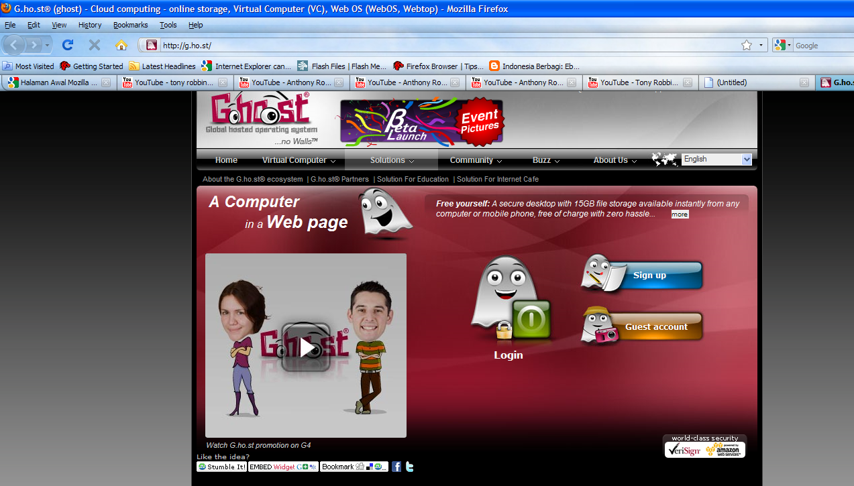
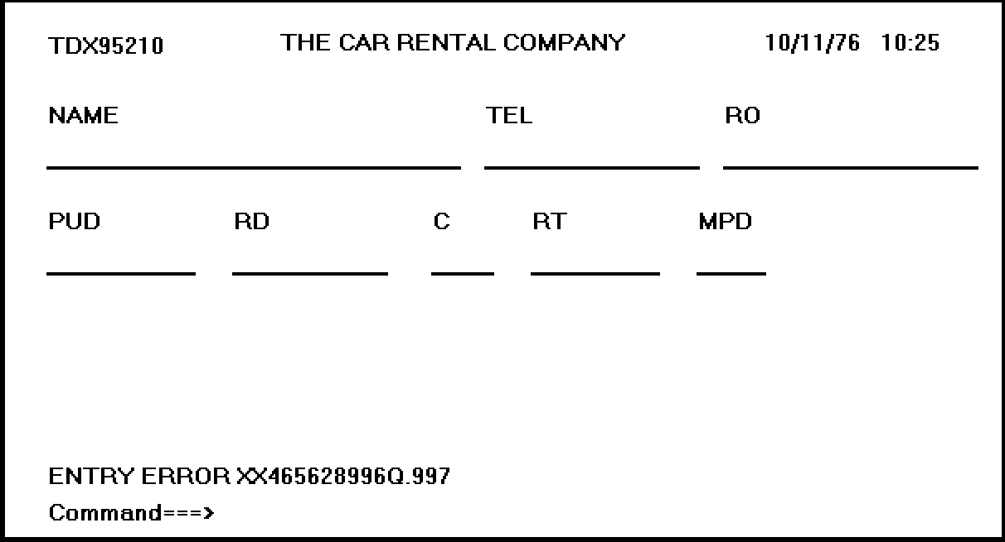
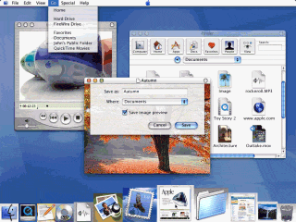
Text Based VS GUI VS Web UI
GUI
Text Based
Web UI

Slide 35
GUI VS WEB UI
KARAKTERISTIK SISTEM DIRECT MANIPULATION
Merupakan potret langsung dari kehidupan nyata
Object dan action selalu terlihat
Rapid and incremental Action with visible display of results
Incremental action are easily reversible

Slide 36
Graphics User Interface (GUI)
STYLE | ADVANTAGES | DISADVANTAGES
Direct Manipulation | Faster Learning, easier remembering, exploits visual/spatial cues, easy error recovery, provides context, immediate feedback, more attractive, easily augmented with text display, low typing req. | Greater design complexity, window manipulation requirements, requires icon recognition, inefficient for touch typist, increased chance for screen clutter, note always familiat, human comprehension limitation, may consume more screen space, hardware limitation.

Slide 37
Characteristics Of GUI
Sophisticated Visual Presentation
Pick and click interaction
A restricted set of interface solution
Visualization
Object orientation
Extensive use of a person’s recognition memory
Concurrent performance of function

Slide 38
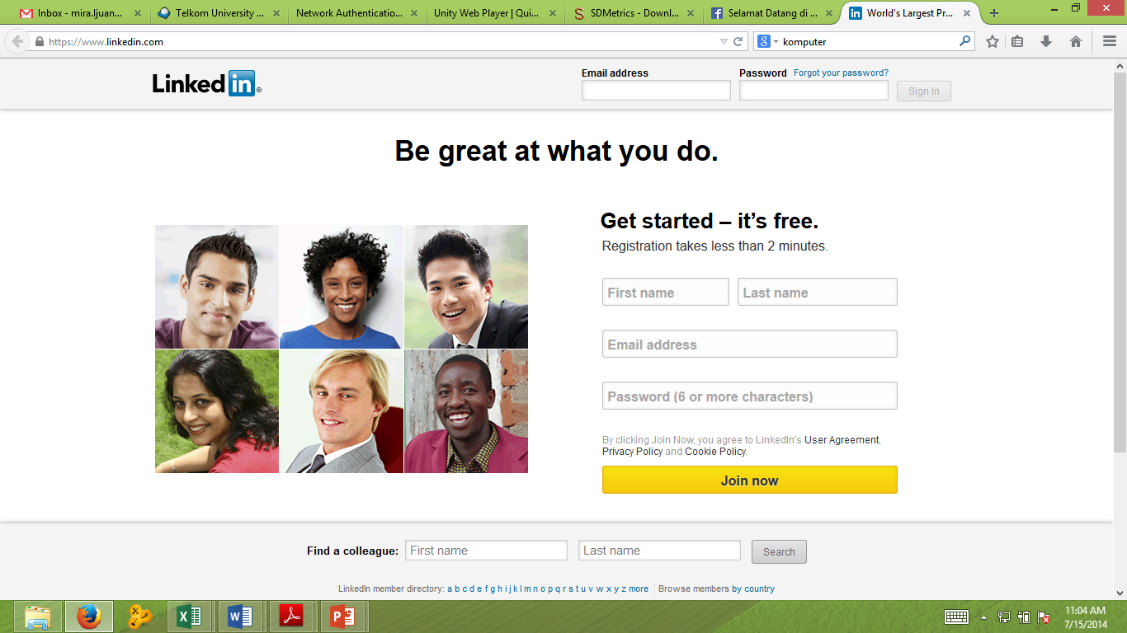
Web User Interface
Hal yang paling mendasar dalam Desain antarmuka Web itu adalah pada desain navigasi dan penyajian informasi. Dalam Web yang paling penting adalah Konten bukan Data
Web Page VS Web Application
More user Control

Slide 39
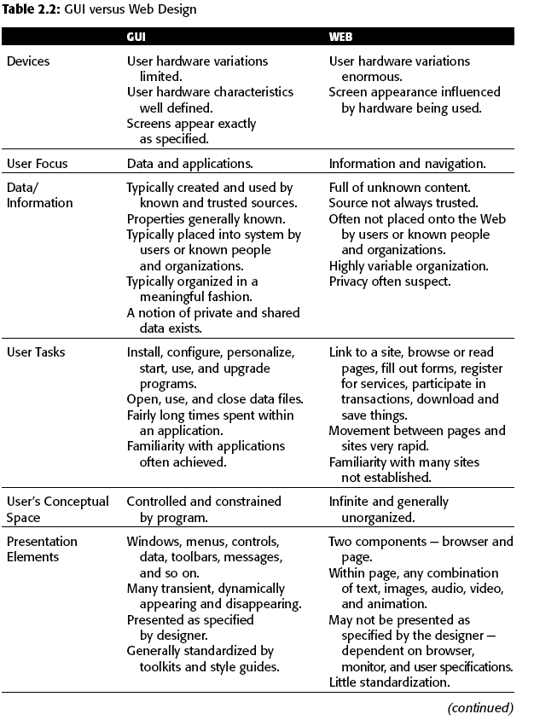
GUI VS WEB UI
Cari tahu lebih banyak perbedaan GUI dan Web dari aspek lainnya, , misal dari aspek Content, Interaction, etc

Slide 40
The merging of graphical business systems and the web
Dimension | Web Application | Web Page | In the middle of continuum
The Nature of the relationship with the user | Users must use the program, Users must identifiy, themselves or login to be able to do anything, The program must be reliable, and system failure will be immediately noticed Work is remembered from earlier session | The system does not care who the user are, Login is required to simply give access to more information than would be received anonymously, System failure may not be noticed | Minimal information such as a credit card number or address is remembered
The Conversation style | The style is formal | The style is casual , informal and generic | The style is polite but friendly
The Nature of the interaction | A Large amount of data is entered, complex task are being performed, data is being created, manipulated and permanently stored | No data is entered or changed | A small amount of data is entered and possibly stored, Milestones, checkpoints, endpoints are expected and included
The Frequency of use | It is used daily, it is used for long period (4-8 Hour), it is used to help resolve emergencies | It is used only occasionally, it is used for only few minutes at a time, it is used to find out about something | It is used periodically or episodically

Slide 41
The merging of graphical business systems and the web (Cont.)
Dimension | Web Application | Web Page | In the middle of continuum
The Perceived distance of the provider | It is viewed as being local in origin, it is viewed as being controlled locally by a data administrator, the response time is fast | The origin is unknown, the origin is viewed as originating somewhere else in the country or overseas, the response time is slow | The origin cannot ascertained or doesn’t matter
Real Time interaction | Data is fed in real time, the information is critical, a delay is life-threatening, long reponses exist but users remain | Time is irrelevant, long response delay exist and cause users to exit | Response is near real time
How much help will users need? | Intense training programs and experience are needed to use and become experts | Every visit is one time session, minimizing or eliminating the need for help | A minimum amount of experience, training or help material is needed
The interaction style | The navigation is controled, controls are complex, the syntax is obejct:Action, there is little or no reversibility, drag and drop manipulation is expected, exit requires users to log off | The navigation is flexible and simple, controls are simple, no object selection is required, action are easily reversed using the back button, no drag-drop manipulation exist, single clicking links are used to navigate | The navigation is flexible, simple data collection exist, user exits by closing web browser
The Presentation style | The Style is subdue and serious | The style is colorfull, graphic, possibly animated, the control are obvious and self explanatory | The style is cooler but attractive
Follow standards | Platform standard compliance exists, the style resembles or matches GUI standard | Few Cross site standard are followed, only intra-site consistently exists | Some common pattern exists

Slide 42
Referensi
Wilbert O. Galitz,2007,The Essential Guide to User Interface Design: An Introduction to GUI Design Principles and Techniques, Third Edition, Wiley Publishing
https://www.youtube.com/watch?v=KtvwustmEDI
https://www.youtube.com/watch?v=gsNQRcSoa9M

